Slide 1

PowerShell and Different types of Data
@JONATHANMEDD
@PSSouthampton

Slide 2
DEMO Heavy
All the examples are in my GitHub repo, so no need to try and copy them down
https://github.com/jonathanmedd/Presentations/tree/master/PSDayUK/2017

Slide 3
BuiltIn cmdlets or something else?

Slide 4
Different Types of data
Text
CSV
Excel
XML
JSON
YAML
May be built in cmdlets
May appear to have built in cmdlets, but may not be the best idea
May require some .NET use for advanced use cases
May require using external PowerShell modules
Most of them have some real world gotchas which I’m going to help prepare you for

Slide 5
reading data from text files
Get-Content
Also, Select-String and New-Object System.IO.StreamReader
Demo
Examples and speed comparisons of working with different size text files: http://www.happysysadm.com/2014/10/reading-large-text-files-with-powershell.html

Slide 6
writing data to text files
Out-File
Set-Content, Add-Content
Demo
Out-File vs Set-Content – what’s the difference?
https://stackoverflow.com/questions/10655788/powershell-set-content-and-out-file-what-is-the-difference

Slide 7
writing data to text files
Pre-PowerShell v6
CmdletName Encoding
---------- --------
Out-File UTF16
Set-Content ASCII
Add-Content ASCII
Export-Clixml UTF16
Export-CSV ASCII
New-ModuleManifest UTF16
Export-PSSession UTF8 (with BOM)
Redirection UTF16

Slide 8
writing data to text files
RFC for PowerShell v6
$PSDefaultEncoding is set by default to UTF8NoBOM
Optional to change $PSDefaultEncoding to WindowsLegacy
Gives a consistent experience on Linux where default encoding is UTF8NoBOM
Look on https://github.com/PowerShell/PowerShell-RFC for RFC0020-DefaultFileEncoding
It seems like $PSDefaultEncoding was agreed, but not implemented https://github.com/PowerShell/PowerShell/issues/10658#issuecomment-538135316
However, the default encoding for cmdlets is UTF8NoBOM

Slide 9
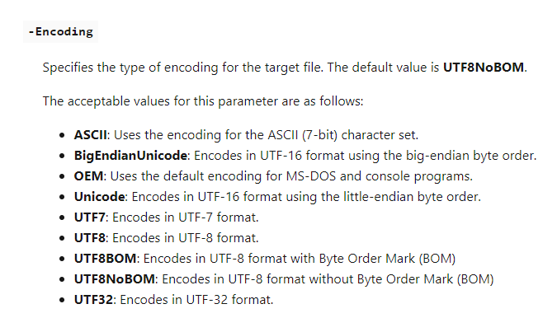
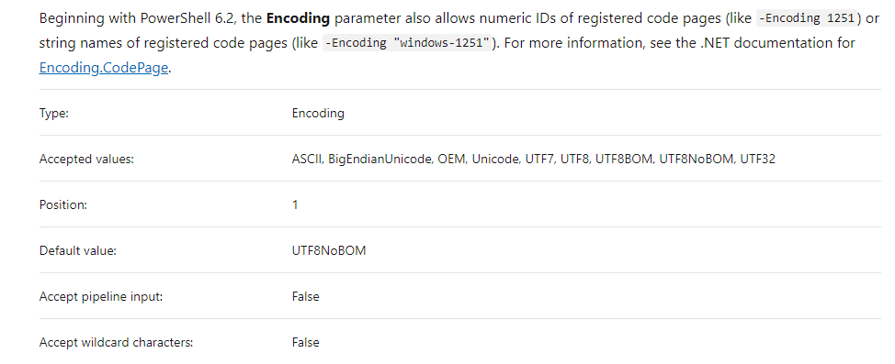
writing data to text files

Slide 10
reading data from CSV files
Import-CSV
Watch out for CSV files with no header
Demo

Slide 11
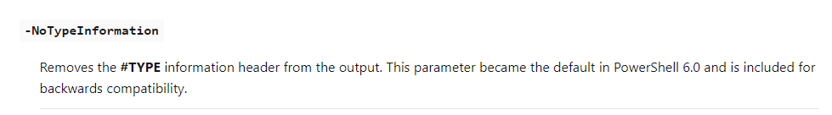
writing data to CSV files
Export-CSV
Watch out for the –NoTypeInformation parameter (prior to v6)
Demo

Slide 12
reading data from EXCEL files
No native support - use as external module, such as the (slightly confusingly named) ImportExcel
Install-Module ImportExcel
Import-Module ImportExcel
Demo

Slide 13
writing data to EXCel files
Use the external module ImportExcel
Export-Excel
Demo

Slide 14
reading data from XML files
What is Import-CliXML?
Only to be used to import an XML file generated by Export-CliXML
Unlikely to be useful with most XML files or data you will need to work with
Typically these cmdlets are used to serialise and deserialse objects
Instead use:
New-Object System.Xml.XmlDocument or
Get-Content and the [xml] Type Accelerator
Then either of these approaches to navigate the data:
XPath
Object dot notation
Good comparison here: https://www.red-gate.com/simple-talk/sysadmin/powershell/powershell-data-basics-xml/
Demo

Slide 15
writing data to XMl files
Use the Save method of System.Xml.XmlDocument
Various methods to manipulate the data before saving
XPath
Object Dot Notation
Demo

Slide 16
reading data from JSON files
Use:
ConvertFrom-JSON
Get-Content to read the data in first from a file or
Receive a JSON response from a web service
Demo

Slide 17
writing data to JSON files
Pipe an object into ConvertTo-JSON
Use Out-File to get it into a file
Demo

Slide 18
reading data from YAML files
No native support - use an external module such as powershell-yaml
Install-Module powershell-yaml
ConvertFrom-Yaml
https://github.com/PowerShell/PowerShell/issues/3607
(Still no resolution after 2+ more years……)
Demo

Slide 19
writing data to Yaml files
Use ConvertTo-Yaml
There is a handy OutFile parameter to get it into a file
Demo

Slide 20
Practical Problem 1
Performance with large JSON datasets
Demo

Slide 21

Practical Problem 2
What to do if the data you are given is not in one of the previous standard structured formats?
Who likes regex?
Checkout ConvertFrom-String
Based on FlashExtract, research work by Microsoft Research.
Demo

Slide 22
Practical Problem 3
Advanced Excel Requests
Demo

Slide 23
SUMMARY
Where possible use the built-in cmdlets
Next best solution will typically be 3rd party module via the PowerShell Gallery or GitHub
Otherwise use some basic .NET to fill a gap or for more advanced scenarios such as performance
https://github.com/jonathanmedd/Presentations/tree/master/PSDayUK/2017

